Slide 1

UE19CS204 – Web Technologies Mini Project
Project Title - Networking and Cataloging web application for tv shows
Section – A
Aaptha BV – PES2UG19CS003
Anish Raghavendra Khatavkar - PES2UG19CS044
Backend: https://github.com/ark893/ReviewProj-Server
Frontend: https://github.com/ark893/ReviewProj-Client

Slide 2
Abstract
We were prompted to make a website which displays many reviews and ratings of different TV shows & Anime by looking at websites such as https://www.imdb.com/ and https://myanimelist.net/ . These websites are quite prevalent these days where we want more information about our favorite shows or actors just because we can have it in our back pocket. These websites serve a niche category of people who are die-hard fans of certain shows.
Our site will be modeled on the websites mentioned above and more. The top panel will consist of the website name and a two categories where you can see a list of movies and create an entry of our own. The list of movies include the movies in the database along with it’s summary and it’s picture. You can create a movie by adding the name, duration, image URL and description. The meat of content will be displayed at the center of the site with each show’s thumbnail which when clicked leads us to a page which contains details and everything else you’d like to see regarding that show.
We will use MongoDB to store all the data for each of the shows, NodeJS for back-end to act as the link between ReactJS and MongoDB and ReactJS to display the data in a proper manner.

Slide 3
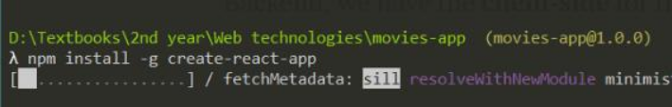
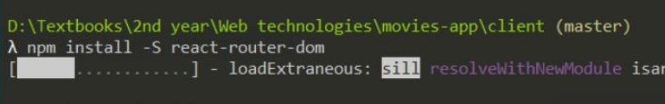
Technologies Used
We have installed and used few additional modules, some of them are listed below:
All the modules should contain “npm install” while installing. We should install node, nodemon and react app the same way. React-router allows us to navigate between different components of the webpage, browser URL etc. We can import the other modules which are already present using “require” command.

Slide 4
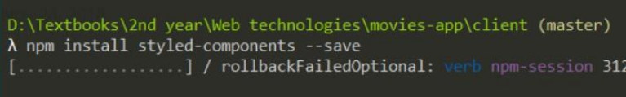
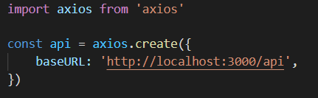
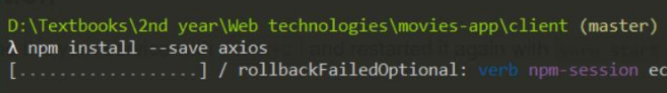
Technologies Used
Note: Axios is also used to connect the front end and the backend. It is used as an alternative to node-fetch which we used in class. Axios performs automatic transforms of JSON data whereas Fetch is a two-step process.

Slide 5
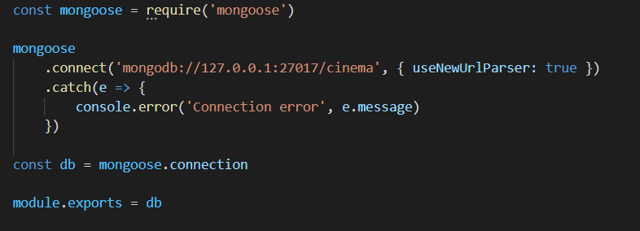
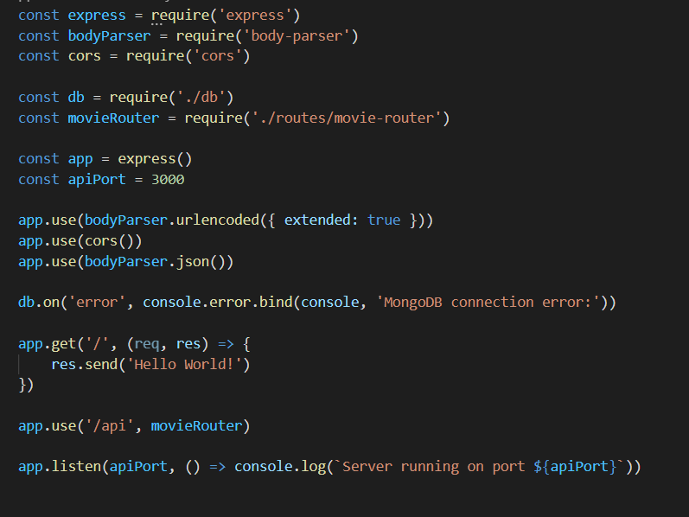
Technologies Used
Connecting mongoDB to the server using mongoose statement. to use this we first import that module
Connecting everything: We connect the movie router, database etc together. As you can see in the picture on the right, we have used the app and it runs in apiPort “3000”. We have also handled error using error.bind statement which gets outputted if the database does not get connected. We then use the app and connect it to movieRouter which has createMovie, deleteMovie, etc.

Slide 6
Member Contributions
Each of us have worked on every layer of this project i.e. the front end, back end and the design.
Aaptha worked mainly on the backend where the movies can be added and deleted. Anish worked mainly on the front end and the connection of front end to the backend. The front end showcases these listed movies in the list section. We have used ExpressJS and reactJS for the front end. NodeJS and mongoDb for the backend.

